Slide 1

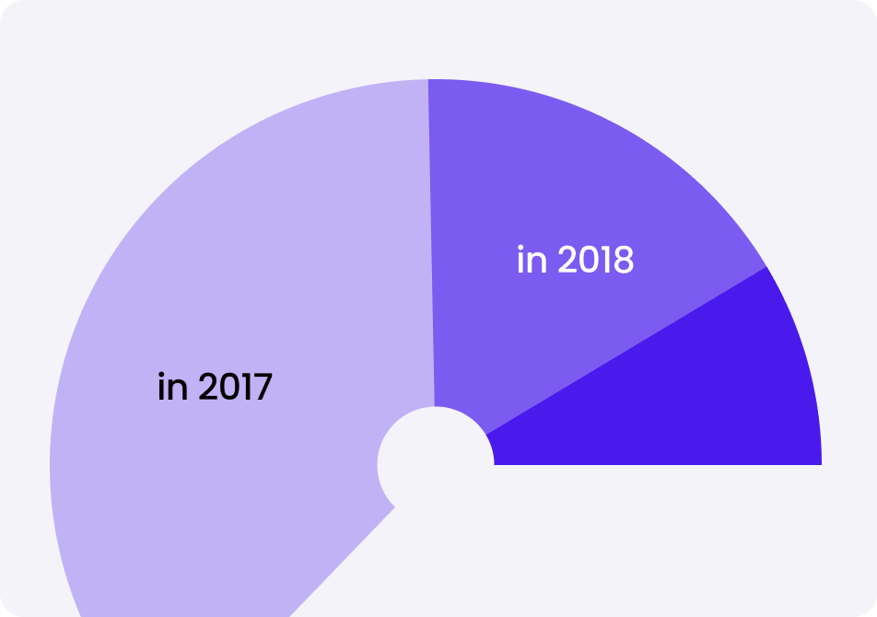
Eg: Category
Infographic Name

